Slide 1
Bell Work (Prepare for Quiz): 1.) Find the slope, and the x and y-intercepts: 2y + 8 = 4x 2.) Write the equation of the line through (2, -5) and (-1, 3)

Slide 2
ALGEBRA 3
Day 19

Slide 3
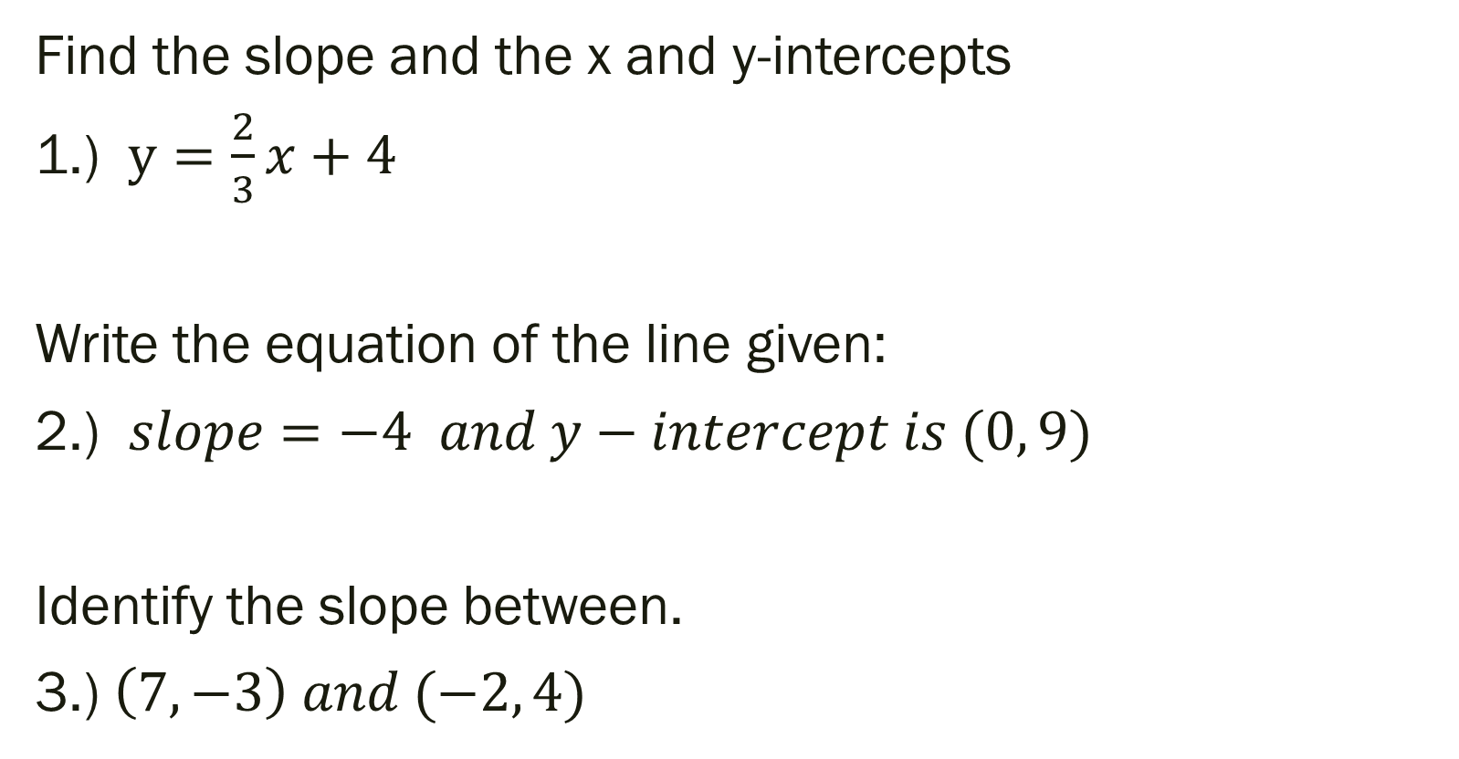
Unit 2 Quiz 1 Level 2
Find the slope and the x and y-intercepts
1.) $y=\frac{2}{3}x+4$
Write the equation of the line given:
2.) $slope=−4 and y−intercept is (0, 9)$
Identify the slope between.
3.) $\left(7, −3\right) and (−2, 4)$

Slide 4
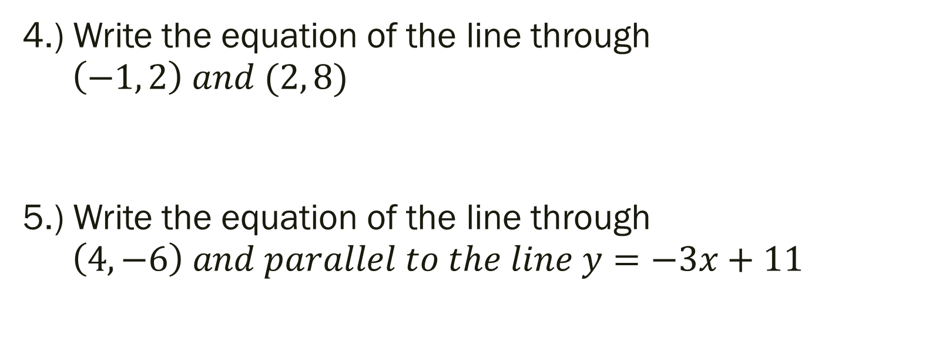
Unit 2 Quiz 1 Level 3
4.) Write the equation of the line through $\left(−1, 2\right) and (2, 8)$
5.) Write the equation of the line through $\left(4, −6\right) and parallel to the line y=−3x+11$

Slide 5
Unit 2 Quiz 1 Level 4
At a school concert, student tickets cost $3 each and adult tickets cost $7 each. The total amount of money earned from ticket sales the first night was $210.
6a.) Write an equation that represents this situation.
6b.) If you know 12 adults were in attendance, how many students went? Show your work from 6a.)

Slide 6
From Last Time…
New Material (Section 2.5)
Page 96 #1, 7, 9, 13, 15-17, 27
New Material (Section 2.6)
Page 103 #5, 6, 13, 19-21, 55

Slide 7
Chapter 2 Section 7 Absolute Value Functions and Graphs
Objective: To graph absolute value functions

Slide 8
Chapter 2 Section 6 Review Remember…
Parent Graph – graph simplest form in a set of functions that form a “family”
Transformation—each function in the “family” that is related to the parent (like the kid to the parent)

Slide 9
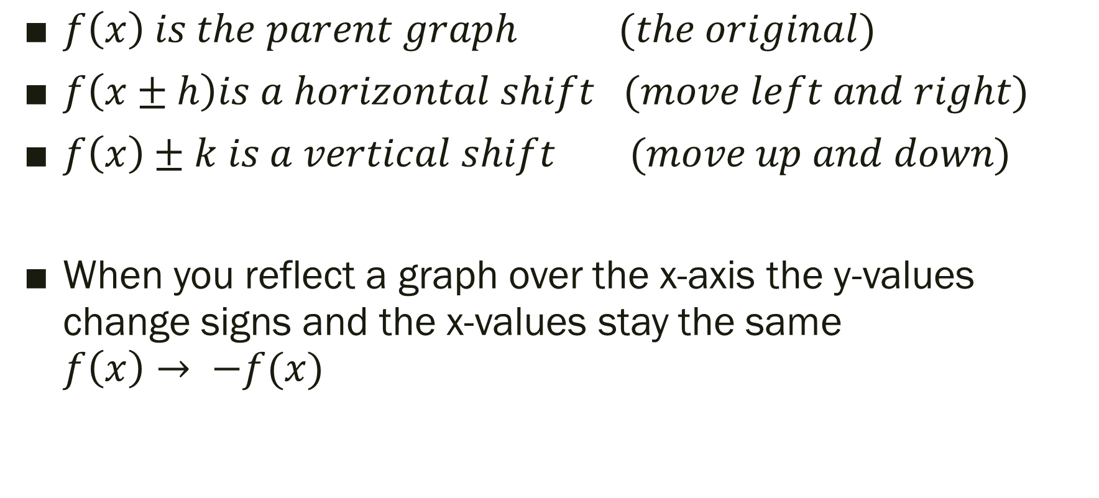
Types of Transformations
$f\left(x\right) is the parent graph (the original)$
$f\left(x±h\right)is a horizontal shift (move left and right)$
$f\left(x\right)±k is a vertical shift (move up and down)$
When you reflect a graph over the x-axis the y-values change signs and the x-values stay the same $f\left(x\right)→ −f(x)$

Slide 10

2.7 Transformation of Absolute Value
Parent Graph:
$$f\left(x\right)=\left|x\right|$$
Transformation of Parent:
$$f\left(x\right)=a\left|x−h\right|+k$$

Slide 11
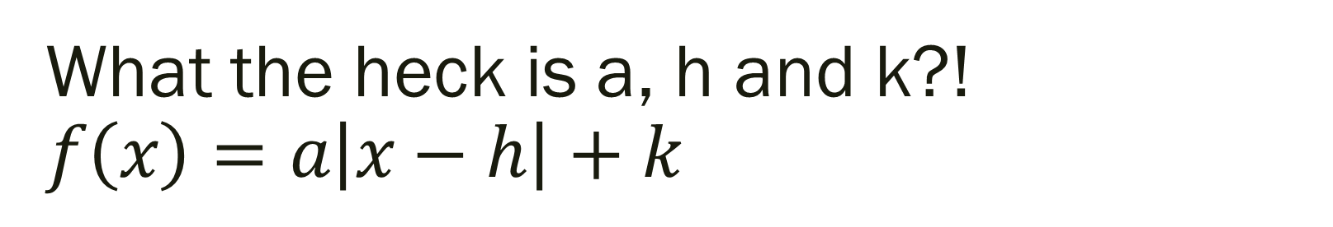
What the heck is a, h and k?! $$f\left(x\right)=a\left|x−h\right|+k$$
The graph is V-shaped
Vertex: (h, k) (think opposite value for h… like before)
Line of Symmetry: x = h (Symmetric about line of symmetry)
a = SLOPE of graph RIGHT of the line of symmetry
Opens up if a > 0 and down if a < 0
h shifts left and right, k shifts up and down

Slide 12

Example (Using Graphing Calculator): Describe the transformation.
Parent Graph $f\left(x\right)=|x|$
1.) $f\left(x\right)=|x+2|$
2.) g$\left(x\right)=\left|x\right|−3$
3.) h$\left(x\right)=\left|x−4\right|+1$
4.) $f\left(x\right)=\frac{1}{3}\left|x+5\right|−4$
5.) $f\left(x\right)=−4\left|x−3\right|+5$

Slide 13
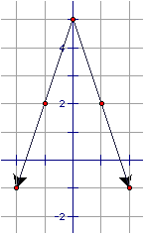
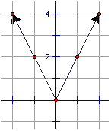
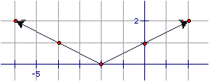
Write the equation of the graphs below…

Slide 14
For Next Time…
New Material
Page 110 #9, 11, 15, 25, 29, 34
Mixed Review
Page 113 #61, 63, 64

